Slide 1
FRAUD DETECTION SYSTEM

Slide 2
Agenda
1.Introduction & Problem Statement
2. Dataset Overview
3. Exploratory Data Analysis (EDA)
4. Feature Engineering
5. Model Development
6. Model Evaluation & Comparison
7. Streamlit Application Demo
8. Business Impact Analysis
9. Conclusion & Future Scope

Slide 3

PROBLEM STATEMENT
Financial fraud represents an accelerating global threat, costing businesses and individuals trillions of dollars annually. With the rapid expansion of digital transactions, fraudsters have found increasingly sophisticated ways to exploit vulnerabilities in financial systems. The challenge lies in detecting fraudulent activities in real-time among millions of legitimate transactions, where fraud typically represents less than 2% of all cases. Global fraud losses are estimated at $5.1 trillion annually, and traditional rule-based detection systems miss approximately 40% of fraud cases. This project addresses this critical challenge by developing a Machine Learning-powered fraud detection system capable of identifying fraudulent transactions with high accuracy while minimizing false positives that could inconvenience legitimate customers.

Slide 4
OBJECTIVE OF THE STUDY
The primary objective of this project is to develop an intelligent system that can detect fraudulent transactions in real-time with exceptional accuracy. This challenge presents several significant obstacles that must be overcome. First, we face a highly imbalanced dataset where only 10.25 % of transactions are fraudulent, making it difficult for models to learn fraud patterns.
Second, the system must operate in real-time, processing transactions within milliseconds to prevent fraud before it occurs.
Third, we must minimize false positives to avoid inconveniencing legitimate customers with unnecessary transaction blocks or investigations.
Fourth, we need to maximize our fraud detection rate to reduce financial losses. Finally, the system must be capable of handling millions of transactions efficiently without compromising performance or accuracy.

Slide 5
DATASET OVERVIEW
Dataset: Fraud Analysis Dataset
Features :
Total Transactions: 11142
Total Features: 10 columns
Features:
step - Time in hourly increments
type - Transaction category (PAYMENT, TRANSFER, CASH_OUT, DEBIT, CASH_IN)
amount - Transaction value
nameOrig - Sender ID
nameDest - Recipient ID
oldbalanceOrg - Sender's balance before transaction
newbalanceOrig - Sender's balance after transaction
oldbalanceDest - Recipient's balance before transaction
newbalanceDest - Recipient's balance after transaction
isFraud - Target variable (0 = Legitimate, 1 = Fraud)

Slide 6
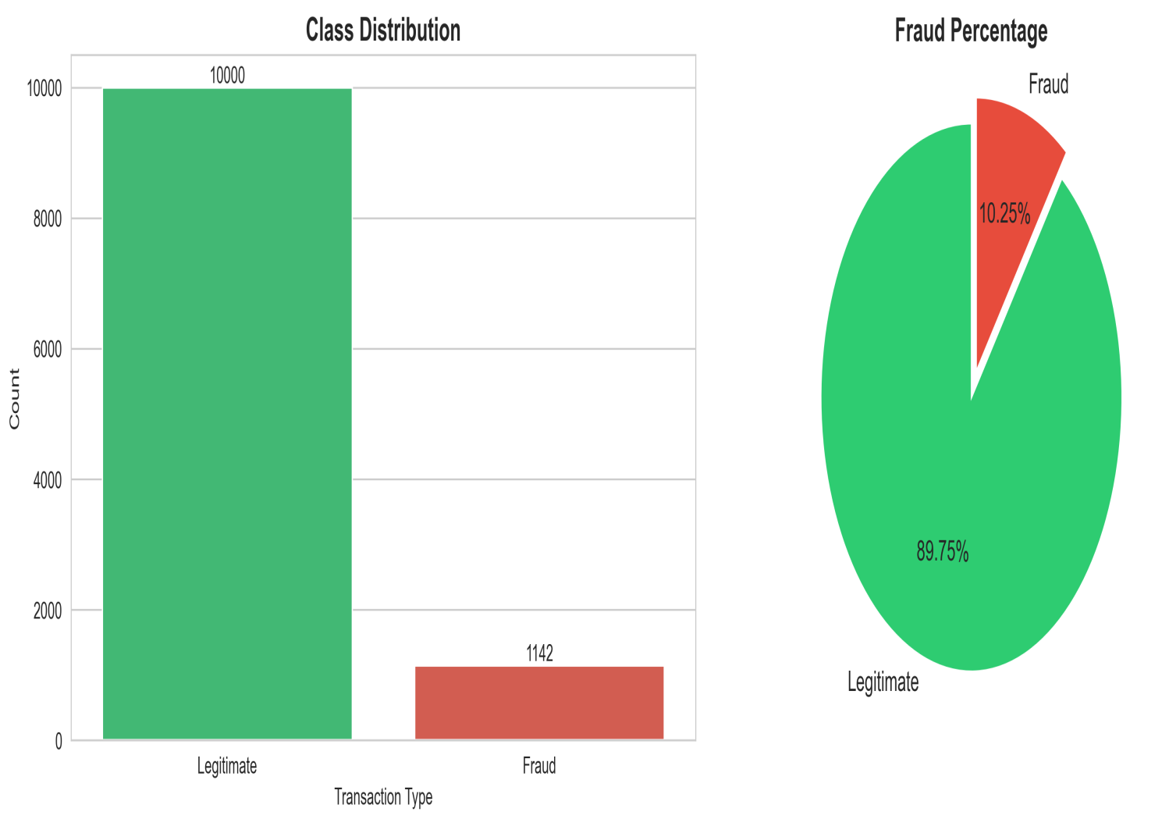
Class Distribution
Heading: Understanding the Imbalance Problem
Class Distribution:
✅ Legitimate Transactions 10000 (89.75 %)
⚠️ Fraudulent Transactions: 1142 (10.25%)
Impact:
Models tend to predict majority class (legitimate)
Special techniques needed: SMOTE, class weights
Evaluation metrics: Focus on Precision, Recall, F1-Score over Accuracy

Slide 7
WORK FLOW
STEP 01 : Data Collection Gathering and organizing data to train machine learning models.
STEP 02 : Exploratory Data Analysis Analyzing and visualizing data patterns to understand its characteristics.
STEP 03 : PREPROCESSING Preparing and cleaning data to enhance its quality and suitability.
STEP 04 :Split Train And Test Data Dividing the dataset into training and testing sets to evaluate.
STEP 05 : Model Selection and Model Training Choosing a suitable machine learning algorithm and optimizing its parameters.
STEP 06 : Model Evaluation Assessing the performance of a machine learning model using metrics.
STEP 07 :Monitor and Update Continuously monitor the model’s performance in the real-world scenario.

Slide 8
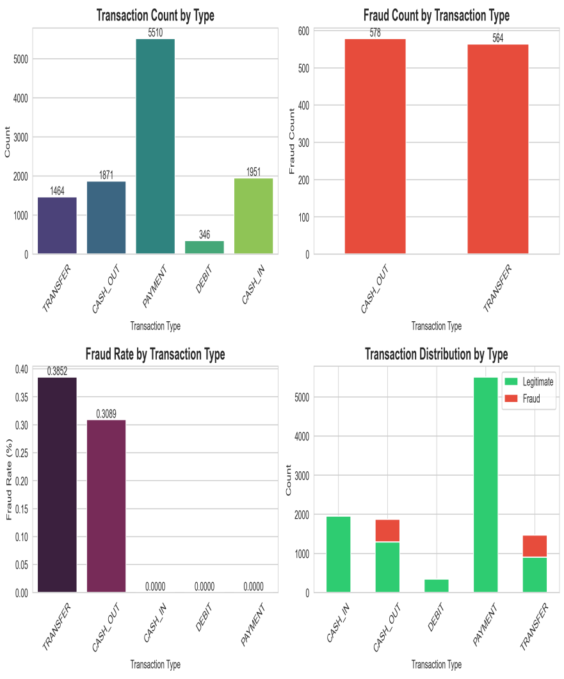
EXPLORATORY DATA ANALYSIS - TRANSACTION TYPE ANALYSIS
Key Findings:
1. Transaction Volume Distribution:
PAYMENT has the highest volume (5,510 transactions)
CASH_IN follows with 1,951 transactions
CASH_OUT: 1,871 transactions
TRANSFER: 1,464 transactions
DEBIT has the lowest volume (346 transactions)
2. Fraud Concentration:
Only 2 transaction types experience fraud: CASH_OUT and TRANSFER
CASH_OUT: 578 fraud cases (highest)
TRANSFER: 564 fraud cases (nearly equal to CASH_OUT)
PAYMENT, DEBIT, and CASH_IN: Zero fraud cases
3. Fraud Rate Analysis:
TRANSFER has the highest fraud rate at 38.52% (highest risk)
CASH_OUT follows with 30.89% fraud rate
PAYMENT, CASH_IN, and DEBIT: 0% fraud rate (completely safe)
4. Transaction Distribution by Class:
PAYMENT is predominantly legitimate (all 5,510 transactions)
CASH_OUT shows significant fraud proportion (578 out of 1,871)
TRANSFER shows highest fraud proportion relative to its volume (564 out of 1,464)
Critical Insights:
⚠️ 38.5% of all TRANSFER transactions are fraudulent - highest risk category
⚠️ 30.9% of CASH_OUT transactions are fraudulent - second highest risk
✅ PAYMENT, DEBIT, and CASH_IN are fraud-free - safe transaction types
🎯 Fraud detection efforts should focus exclusively on TRANSFER and CASH_OUT transactions

Slide 9
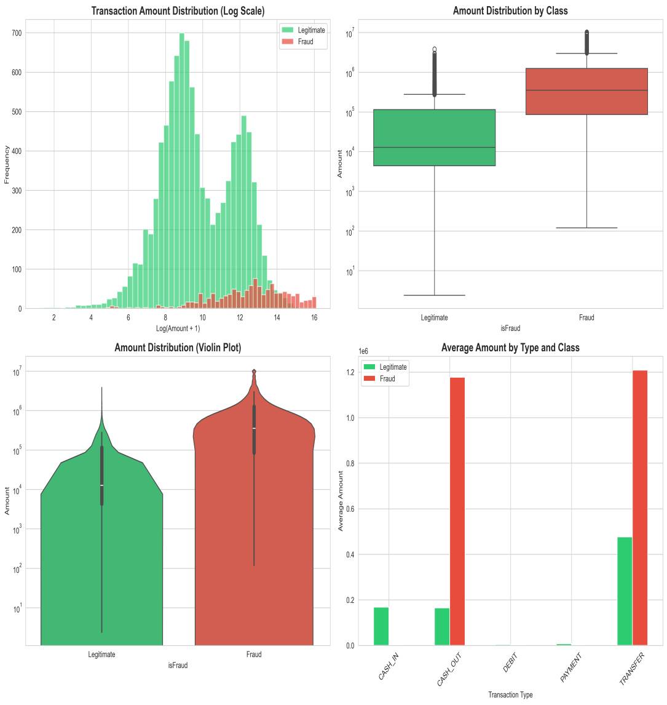
EXPLORATORY DATA ANALYSIS - AMOUNT AND BALANCE PATTERNS
Transaction Amount Distribution (Log Scale):
Legitimate transactions (green) show a normal distribution concentrated around log amount 8-10.
Fraud transactions (red) are distributed across higher amount ranges (log 10-16) Fraud amounts
are more spread out and skewed toward higher values .Peak legitimate transactions: ~$22,000 - $150,000 range Fraud transactions extend to much higher amounts
Amount Distribution (Violin Plot):
Legitimate transactions:
Dense concentration in lower-middle range
Narrower distribution
Most transactions between $10,000 - $500,000
Fraud transactions:
Broader, more uniform distribution
Higher concentration at upper ranges
Significant density at $100,000 - $1 million range

Slide 10
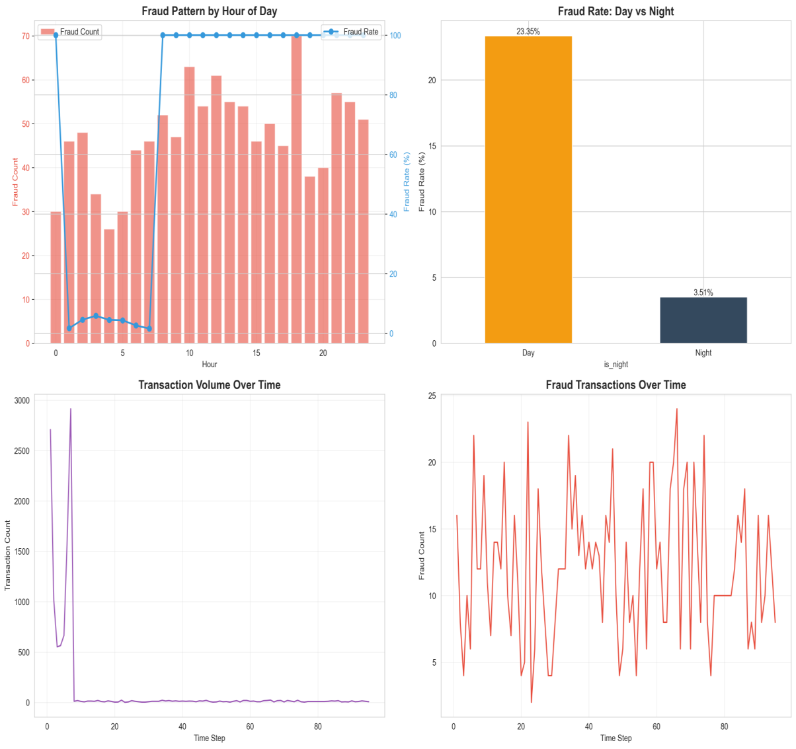
TIME-BASED PATTERN ANALYSIS
Key Findings:
Hourly Fraud Patterns:
Peak fraud hours: 7-8 AM and 18-19 PM (evening)
Fraud count: 45-70 transactions during peak hours
Fraud rate: Remains relatively stable (~100%) after hour 7
Lower activity: Hours 0-6 AM and late night show reduced fraud counts
Day vs Night Comparison:
Day fraud rate: 23.35% (significantly higher risk)
Night fraud rate: 3.51% (6.6x lower than day)
⚠️ Daytime transactions are 6.6 times more likely to be fraudulent
Transaction Volume Over Time:
Massive spike at time step 1 (~2,900 transactions)
Normal activity drops to ~50 transactions per time step afterward
Consistent low volume throughout the 30-day period
Fraud Transactions Over Time:
Fluctuating pattern: 4-24 fraud cases per time step
Peak fraud activity: Around time step 60 (~24 cases)
Cyclical patterns visible with periodic spikes
Average: 12-16 fraud cases per time step

Slide 11
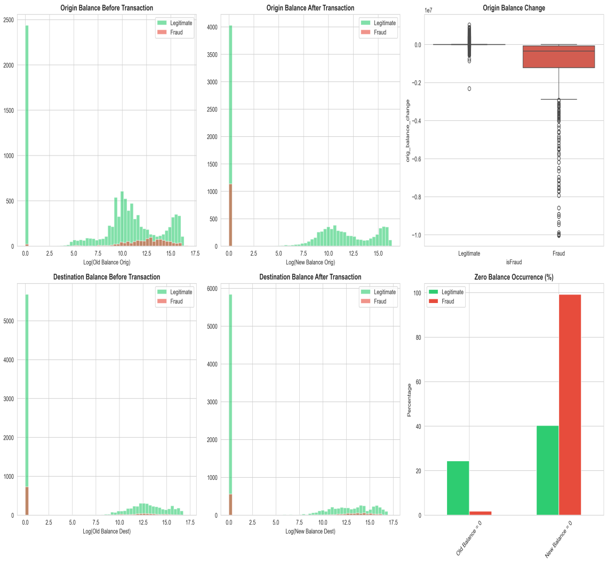
BALANCE PATTERN ANALYSIS
1. Origin Balance Before Transaction
Most legitimate transactions begin with a non-zero origin balance, but many have a zero balance as well.
Fraudulent transactions show very few high pre-transaction balances.
2. Origin Balance After Transaction
After legitimate transactions, many accounts still retain balance, but for fraudulent transactions, most new balances drop to zero.
3. Origin Balance Change
Boxplot indicates that legitimate transactions have minor balance changes, while fraud often wipes out the account, resulting in large negative changes with minimal variance.
4. Destination Balance Before Transaction
Majority of destination accounts for both transaction types start at zero, but more so for fraudulent ones.
5. Destination Balance After Transaction
Legitimate destination balances remain distributed, but fraudulent destination accounts are almost always at zero after the transaction.
6. Zero Balance Occurrence (%)
For fraudulent transactions, nearly 100% of the destination accounts have a new balance of zero, compared to about 25-30% for legitimate cases.
Old balance zero occurrence is less than 10% for fraud, higher for legitimate.

Slide 12
FEATURE CORRELATION ANALYSIS
Top 15 Features Correlated with Fraud:
Highest Correlation (Strongest Fraud Indicators):
step (0.85) - Time step shows strongest correlation
hour (0.60) - Hour of day is highly predictive
HighAmount_AND_NewOrigin (0.40) - High amounts from new accounts
amount (0.38) - Transaction amount
log_amount (0.38) - Logarithmic transformation of amount
Moderate Correlation: 6. Empties_Origin_Account (0.35) - Account draining behavior 7. Both_NewAccounts (0.25) - Both parties are new accounts 8. amount_x_error (0.20) - Amount multiplied by balance error 9. IsNight_AND_HighAmount (0.18) - High value night transactions 10. dest_balance_change (0.15) - Destination balance changes
Lower Correlation (Still Significant): 11. receiver_error (0.12) - Destination balance discrepancies 12. total_balance_error (0.10) - Combined balance errors 13. oldbalanceOrg (0.08) - Origin starting balance 14. amount_to_oldbalance_dest_ratio (0.07) - Amount-to-balance ratio 15. newbalanceDest (0.05) - Destination ending balance

Slide 13
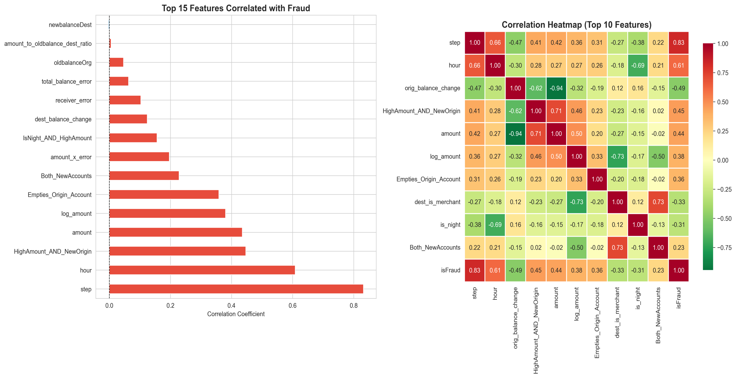

Slide 14
FEATURE ENGINEERING
Feature engineering was a critical part of the project, resulting in over 30 intelligent features to boost fraud detection performance.
Mathematical transformations included applying log transformation to transaction amounts to address skewed value distributions.
Time-based features were derived, such as extracting the hour of the day, a binary indicator for night transactions (0-6 AM), and a weekend indicator.
Customer behavior features were created to capture transaction frequency for both senders and receivers, and to identify whether accounts belonged to merchants.
Balance analysis features measured changes in both origin and destination balances, and calculated balance errors to find discrepancies between expected and actual balances.
Ratio features were engineered, comparing each transaction amount to respective account balances for both origin and destination accounts.
Seven advanced suspicious pattern flags were incorporated, including:
Indicators for transactions with zero-balance origins but positive amounts.
Destinations that did not increase in balance despite receiving funds.
High transaction amounts from new origin accounts.
Accounts being completely emptied.
High-value transactions occurring during night hours.
These engineered features significantly enhanced the model’s ability to identify subtle and complex fraud patterns.

Slide 15
DATA SPLITTING
Dataset Size: 11,142 samples with 34 engineered features.
Class Imbalance: Fraud accounts for only 10.25% of the data, with an imbalance ratio of approximately 1:8.76.
Data Splitting: Stratified split into training (60%), validation (20%), and test (20%) sets:
Training: 6,684 samples
Validation: 2,229 samples
Test: 2,229 samples
Fraud rate remains consistent across all splits (~10.2%), preserving class proportions.
Feature Scaling: Applied and saved for reuse (scaler.pkl), ensuring consistent preprocessing across training and deployment.
This setup ensures balanced evaluation, reproducibility, and readiness for model experimentation.

Slide 16
MODEL SELECTION
We implemented and compared five different machine learning models to identify the optimal approach for fraud detection.
Logistic Regression served as a simple, interpretable baseline model.
Random Forest Classifier, an ensemble of decision trees, was the best performer overall.
XGBoost offered powerful gradient boosting, effective for structured data.
LightGBM provided fast and efficient gradient boosting with low training times.
Isolation Forest was used as an unsupervised anomaly detection method.
All models were trained and evaluated on the same preprocessed data using identical metrics for fair comparison.
This approach allowed thorough exploration of different algorithms to select the most effective model for the fraud detection task.
This model comparison strategy ensured a well-rounded evaluation and selection of the optimal fraud detection approach.

Slide 17
MODEL COMPARISON
Models | Train Accuracy | Validation Accuracy | Overfitting Gap | Validation Precision | Validation Recall | Validation F1-Score | Validation ROC AUC | Training Time (s)
Random Forest | 1.000 | 1.000 | 0.000 | 1.000 | 0.996 | 0.998 | 1.000 | 1.749
XGBoost | 1.000 | 1.000 | 0.000 | 1.000 | 0.996 | 0.998 | 1.000 | 1.049
LightGBM | 1.000 | 1.000 | 0.000 | 1.000 | 0.996 | 0.998 | 0.996 | 1.363
Logistic Regression | 0.995 | 0.996 | -0.001 | 0.991 | 0.969 | 0.980 | 0.999 | 0.357
Isolation Forest | 0.863 | 0.866 | -0.003 | 0.330 | 0.297 | 0.313 | NaN | 0.655

Slide 18
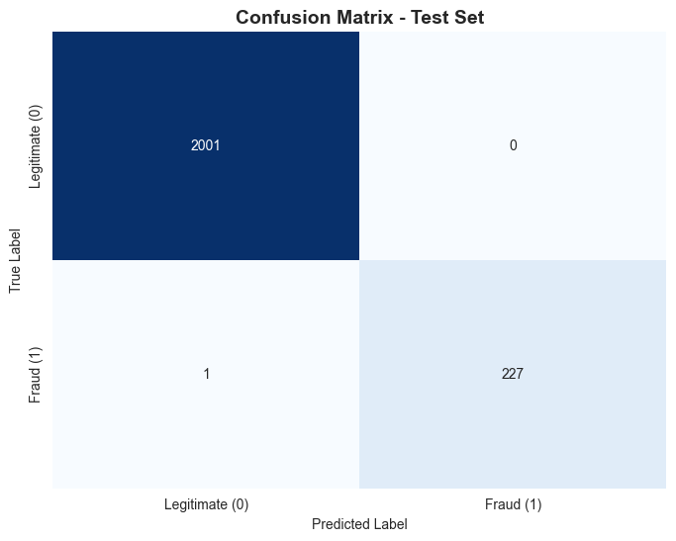
MODEL EVALUATION
The Random Forest model was evaluated on the test set to detect fraudulent transactions. Metrics like precision, recall, F1-score, and ROC-AUC show that the model effectively identifies most fraud cases while keeping false alarms low, demonstrating strong overall performance.
 | Precession | Recall | F1 Score | Support
0 | 1.000 | 1.000 | 0.000 | 1.000
1 | 1.000 | 1.000 | 0.000 | 1.000
accuracy | 1.000 | 1.000 | 0.000 | 1.000
Macro avg | 0.995 | 0.996 | -0.001 | 0.991
weighted avg | 0.863 | 0.866 | -0.003 | 0.330

Slide 19
ESTIMATING FINANCIAL BUSINESS IMPACT
we analyze how the model’s predictions could affect the business financially. By calculating the potential savings from correctly detected frauds and the losses from false negatives or false positives, we can estimate the overall monetary benefit of using the model in real-world transactions. This helps quantify the practical value of the fraud detection system.
Estimating Financial Business Impact
Confusion Matrix values:
True Negatives (TN): 2,001
False Positives (FP): 0
False Negatives (FN): 1
True Positives (TP): 227
Total amount saved from True Positives: $235,430,525.04 Total cost from False Positives: $0.00 Total cost from False Negatives: $416,001.33
Estimated Net Financial Impact: $235,014,523.71
This means the fraud detection model successfully saved over 235 million dollars by correctly identifying fraudulent transactions, with minimal costs due to false negatives and no cost related to false positives. This reflects a strong positive financial outcome from the fraud detection solution.

Slide 20
FRAUD DETECTION SYSTEM STREAMLIT APPLICATION
The developed Fraud Detection System provides a real-time interface for predicting fraudulent transactions using machine learning. Users can input transaction details such as type, amount, account balances, and time variables for single transactions. Upon submitting data, the system processes these features and outputs an instant fraud risk assessment.
In the illustrated example, the model flagged a transaction as fraudulent with a 70% probability, clearly alerting users to suspicious activity along with key supporting metrics like balance error and account changes. This intuitive and informative interface streamlines transaction monitoring and supports effective fraud prevention for financial institutions.

Slide 21
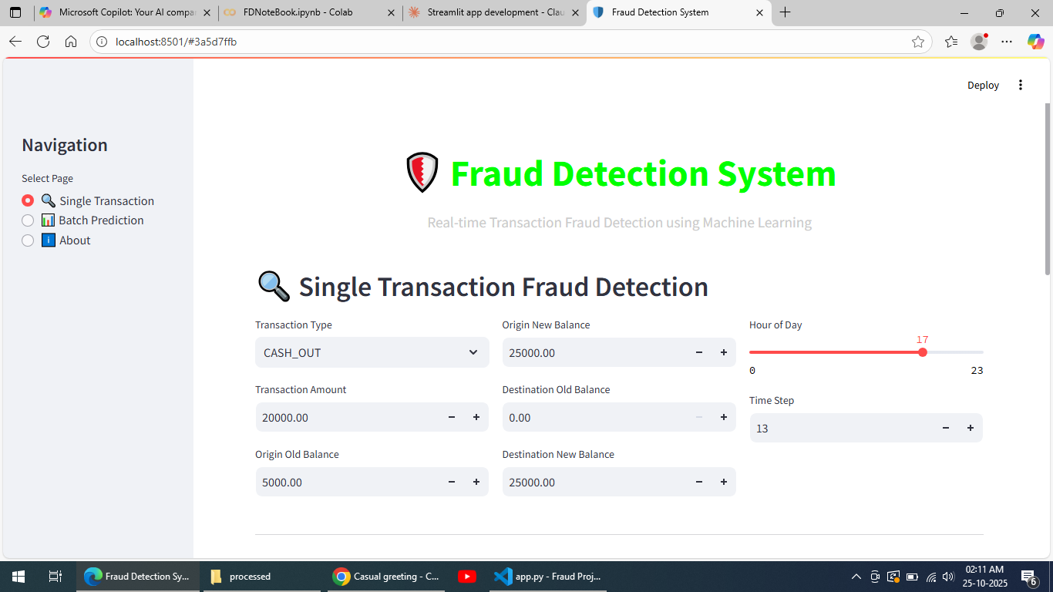
SCREENSHOT FOR STREAMLIT APPLICATION PROJECT

Slide 22
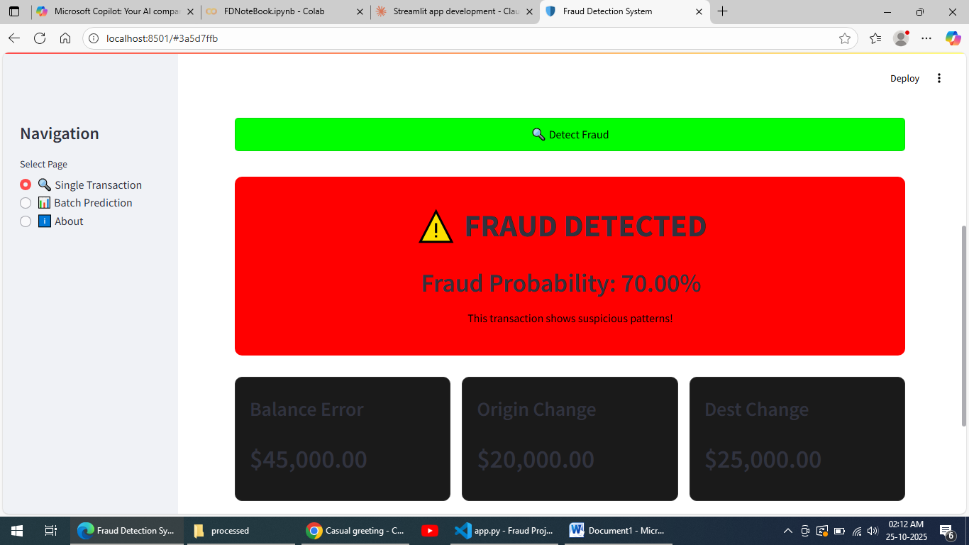
Screenshots

Slide 23
Questions ?

Slide 24
Thank You!

